Slide 1

IEEE SAINTGITS STUDENT BRANCH – SPINHACK 2025
TESLA PRESSURE COOKER
PRESENTED BY:- GENESYS, PROVIDENCE COLLEGE OF ENGINEERING

Slide 2
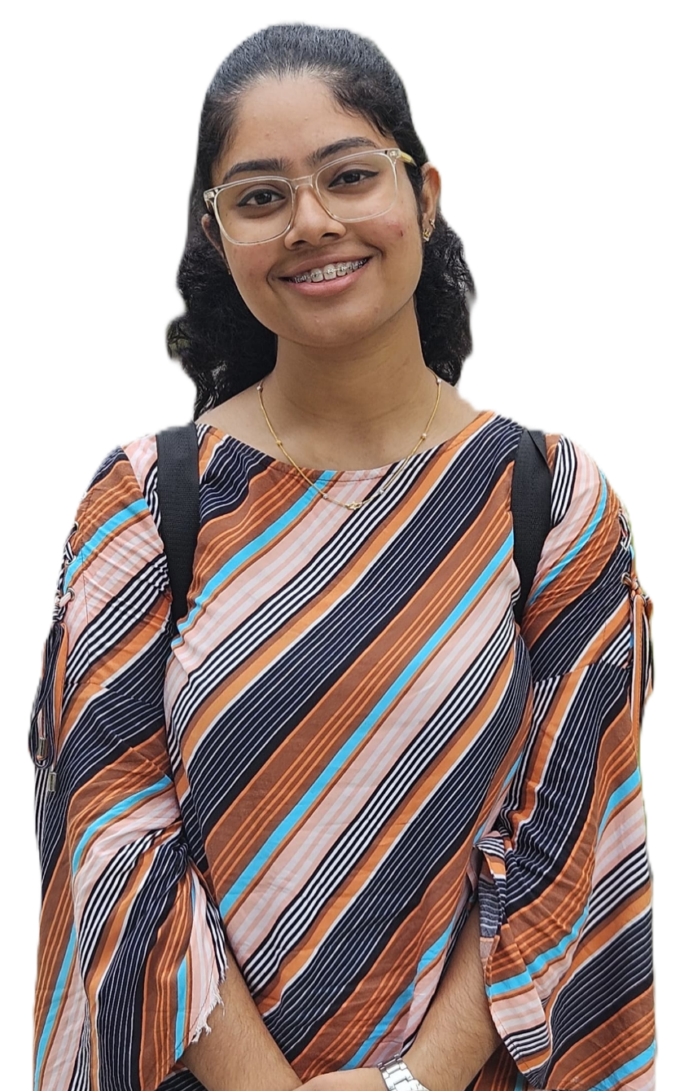
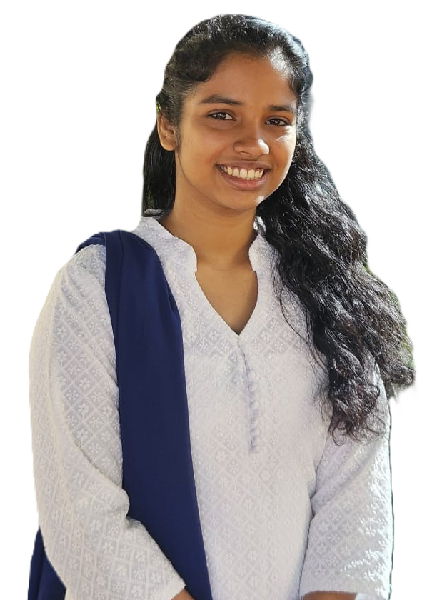
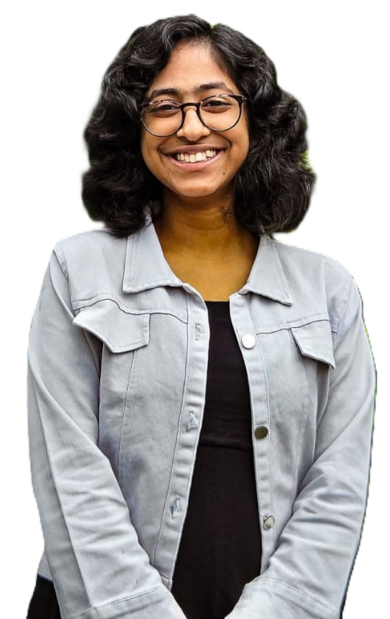

Know The Team GENESYS

Slide 3

Know The Team GENESYS
Anju Ruth Abraham

Slide 4
Know The Team GENESYS
Jesty Jose

Slide 5
Know The Team GENESYS
Julienne Brijit Jacob

Slide 6
Know The Team GENESYS
V. S. Mekha

Slide 7
Problem & Idea
Problem:
Traditional pressure cookers lack modern safety, nutrition, and smart cooking features.
Users face issues such as accidental burns, overcooked food, lack of nutritional tracking, and time inefficiency.
Idea:
Create a smart pressure cooker using AI and sensor technology to enhance safety, nutritional value, and ease of use.
Build a marketing website to promote and explain the features of this futuristic appliance.

Slide 8
Our Approach
We follow a user-centric design, identifying pain points in cooking (e.g., safety, nutrition, time).
The website will have a minimalist and visually appealing design, focusing on clarity and user interaction.
Using agile sprints, we prototype sections like product showcases, interactive demos, and a recipe hub.
Modern web frameworks ensure responsiveness and scalability.
The smart cooker is designed to be modular for future upgrades.

Slide 9
Our USP / Key Features
Nutrient Calculation for tracking and optimizing health outcomes
Anti-Burning Sensor to avoid food accidents
Steam-Resistant Built-in Camera for real-time visual monitoring (installed inside the lid)
Voice & Light Indicators for alerts and status updates
AI-Based Cooking Assistant for personalized step-by-step cooking help
Maintenance Reminders to ensure long-term usability
Scent Exhaust Diffuser for a better kitchen environment
Dual-Zone Pressure Cooking to cook two types of food simultaneously with different settings.

Slide 10
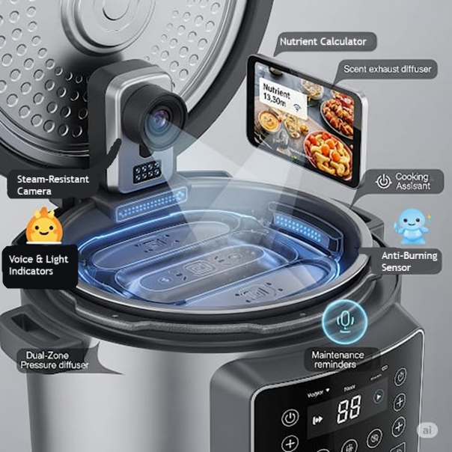
Our USP / Key Features

Slide 11
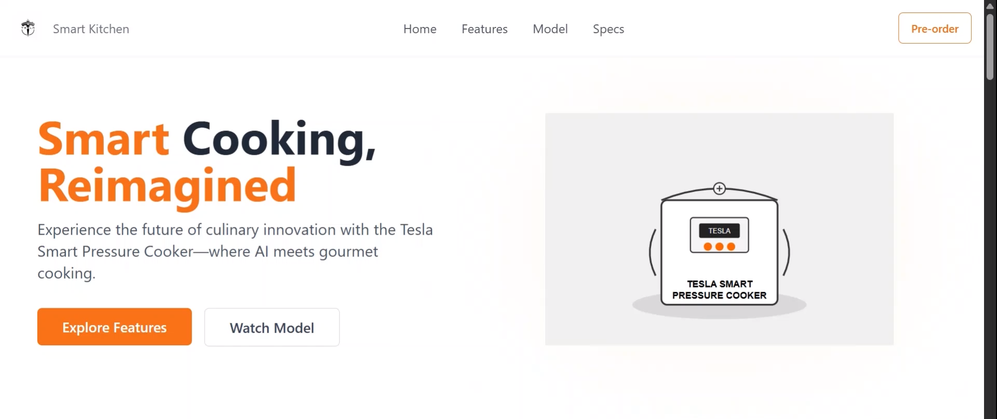
Live Demo

Slide 12
Tools We Used
ChatGPT – Helped identify problems and improve user experience through AI-driven suggestions.
Gemini – Used for writing abstracts, marketing lines, and initial logo ideas.
DALL·E – Designed promotional graphics and icons for our brand.
Bolt.New – Auto-generated website code and structured our API integration.
MGX – Utilized for webpage creation, including layout and structural elements.

Slide 13
Impact of Our Project
Enhances kitchen safety by preventing burns and overcooking
Supports healthier cooking through nutrient tracking
Increases user convenience with AI guidance and voice indicators
Boosts market innovation with unique and futuristic features
Engages users through a vibrant website and community space, fostering loyalty and brand growth.

Slide 14
Future Improvements
Expand into IoT integrations (e.g., smart home sync)
Add multi-language support for global reach
Explore recipe personalization based on diet history.

Slide 15
THANK YOU

